Slide 1
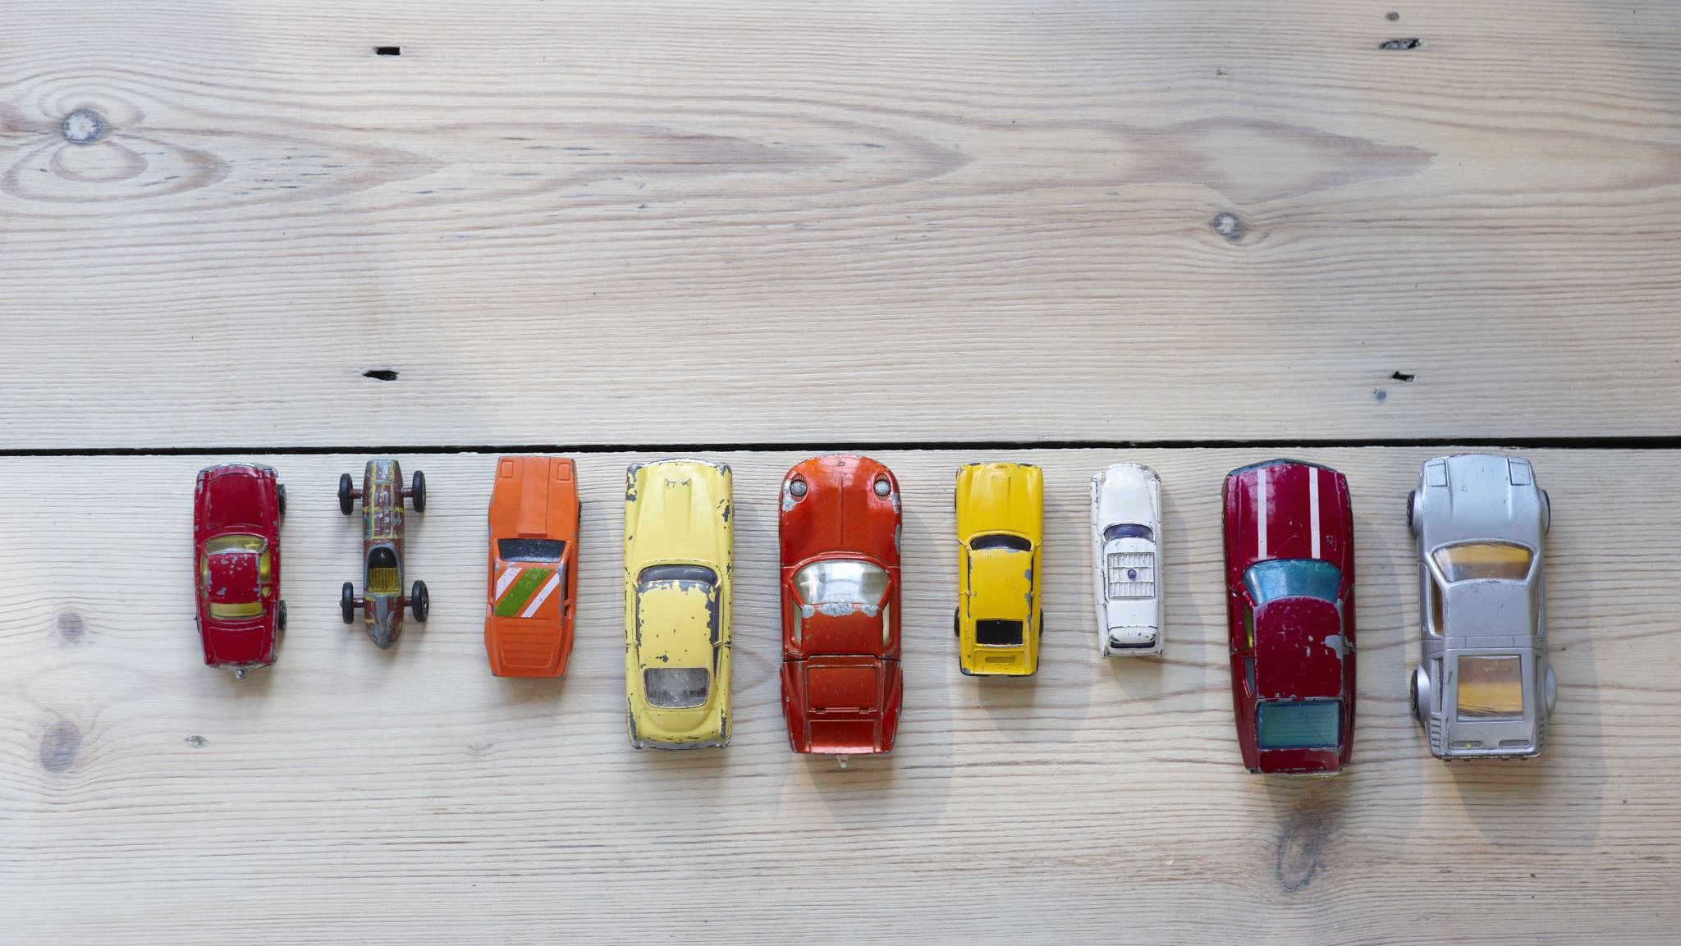
CO₂ Emissions and Fuel Consumption of Different Car Models
Zaid Al-Jawadi

Slide 2
Problem Overview
Predict CO2 emissions (g/km) using car features
Potential Impact:
Quantify CO2 emissions for a given car
Potentially quantify vehicular CO2 emissions in a city
Assess how technology has evolved in reducing CO2 emissions from 1995 – 2023

Slide 3
Dataset
Target variable: CO2 emissions (g/km)
Features:
Car year
Car make
Vehicle class
Engine size
Transmission
Cylinders
Fuel consumption (city/hwy/combined)
Fuel Type
(27k rows, 15 columns)

Slide 4
Preprocessing and EDA
Strong positive correlation between CO2 emissions and:
Fuel consumption
Cylinders
Engine size
Bigger vehicles emit more CO2
No strong correlation between year of car make and CO2 emissions
Suggests no drastic change in technology

Slide 5
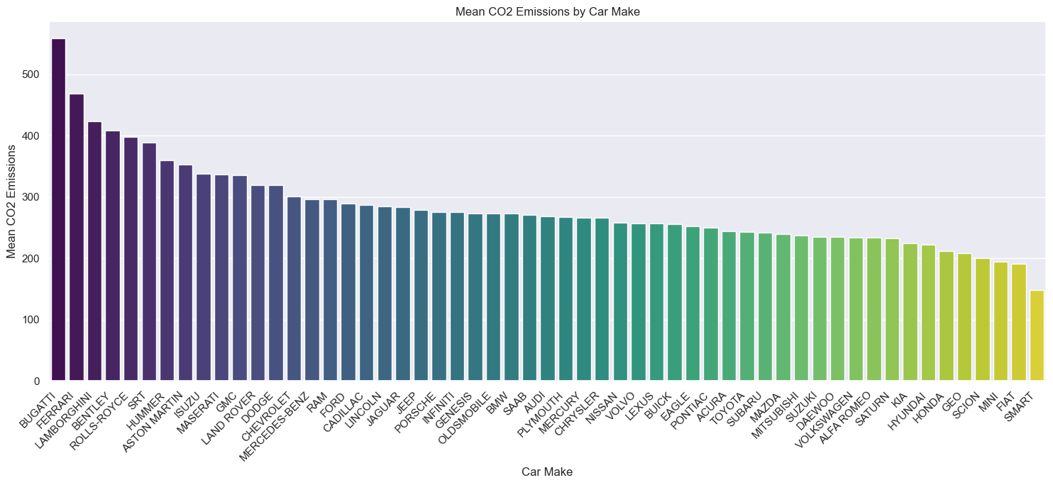
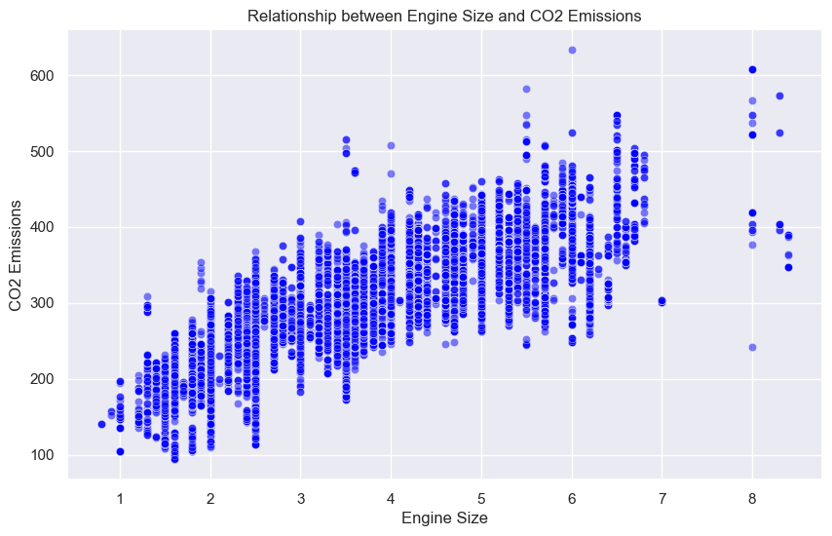

Slide 6


Data Modeling Approach
Linear Regression
Decision tree
Random forest
kNN

Slide 7
Data Modeling Approach
Linear Regression
Decision tree
Random forest
kNN

Slide 8
Evaluation Metrics
Root mean squared error (RMSE)
R-squared
Percentage mean absolute error (PMAE)
Linear Regression: 0.99
Decision Tree: 0.99
Linear Regression: 23
Decision Tree: 6

Slide 9

Next Steps
Apply PCA
Random forest
kNN
Neural Networks
Finetune linear regression and decision tree

Slide 10


Thank you!

